Slide 1
in silico ANALYSIS OF ANTIMICROBIAL PEPTIDES IN Bombyx mori TOWARDS THE DEVELOPMENT OF THERAPEUTICS
Group members:
Ahish M Sujay (1MS15BT003) Mounika Rao (1MS15BT024)
Nidhi Hookeri (1MS15BT028) Yogesh P (1MS15BT058)
GUIDE:
Sravanti V, Phd, associate professor, department of biotechnology, ramaiah institute of technology, bengaluru

Slide 2
INTRODUCTION
Antimicrobial peptides (AMPs) are oligopeptides (5-100 amino acids) that are a part of the innate immune system in all organisms like plants, animals and insects.
This study is focused on AMPs in Bombyx mori.
Currently, there are several multi drug resistant microbes – Superbugs. Therefore, the need of the hour is to develop new molecules which have antimicrobial properties against superbugs.
Applications:
Therapeutic uses
Inhibition of Biofilm
Aquaculture
Animal Husbandry
Food Industry

Slide 3

SILK WORM - Bombyx mori
Used as a model organism for life sciences :
Low breeding cost, Large progeny size, Short generation time and Clear genetic background
Highly homologous to certain genes related to human hereditary disease
28 pairs of chromosomes, Silkworm genome is about 450 million bp which is 1/6th of the human genome.
Cecropins are active against parasites like Plasmodium and Trypanosoma and can inhibit the replication of HIV-1 virus and proliferation of cancerous cells.
LATEST ARTICLES DEPICTING THE NEED OF THE HOUR

Slide 4
REVIEW OF LITERATURE
Title | Authors | Conclusion
Silkworm: A Promising Model Organism in Life Science | Xu Meng, Feifei Zhu, and Keping Chen | Advantages of silkworm as a model organism particularly for screening of antimicrobial drugs, as a human disease model, for environmental monitoring and in pest control
Sequence diversity and evolution of antimicrobial peptides in invertebrates | Anchalee Tassanakajon, Kunlaya Somboonwiwat, and Piti Amparyup | The sequence diversity of invertebrate AMPs (Defensins, Cecropins, Crustins and Anti-lipopolysaccharide factors) were presented to provide a better understanding of the evolution pattern of these peptides that play a major role in host defense mechanisms in invertebrate animals
The therapeutic applications of antimicrobial peptides (AMPs): a patent review | Hee-Kyoung Kang, Cheolmin Kim, Chang Ho Seo, and Yoonkyung Park | The paper presented the structure of AMPs, their mechanism of action and biological activity with the current and future developments of AMPs
A Review on Antimicrobial Peptides from Bombyx mori L and Their Application in Plant and Animal Disease Control | Sebrin Jahan Islam, Sukanya Bezbaruah, and Jatin Kalita | The paper gave a detailed account on Cecropin, Defensin, Moricin, Gloverin, Attacin and Lebocin classes of AMPs in Bobmyx mori with the application of these AMP's in plant disease control and pest management
Expression of Antimicrobial Peptide Genes Encoding Enbocin and Gloverin Isoforms in the Silkworm, Bombyx Mori | Yoichi Kaneko, Seiichi Furukawa, Hiromitsu Tanaka, and Minoru Yamakawa | The results gave the amino acid sequences of Enbocin2 and Enbocin3 with the time course of expression of Enbocin and Gloverin isoform genes

Slide 5
Title | Authors | Conclusion
Antimicrobial peptides from insects with special reference to silkworm Bombyx mori L: A review | ZI Buhroo, MA Bhat, GK Bali, AS Kamili, and NA Ganai | The paper gave a detailed account on Cecropin, Defensin, Moricin, Gloverin, Attacin and Lebocin classes of AMPs in Bobmyx mori with the application of these AMP's in plant disease control and pest management
Molecular Cloning, Bioinformatic Analysis, and Expression of Bombyx mori Lebocin 5 Gene Related to Beauveria bassiana Infection | Dingding Lü, Chengxiang Hou, Guangxing Qin, Kun Gao, Tian Chen and Xijie Guo | By NetOGlyc 4.0 Server, an Oglycosylation site was also predicted at Thr15 of BmLeb5 mature peptide as in other peptides of lebocins, suggesting that BmLeb5 is also an O-glycosylated antimicrobial peptide and could also play an important role to defend the microbial Invasion.
Advances and applications of bioinformatics in Sericultural research | M Younus Wani, NA Ganie, S Rani, S Mehraj, MF Baqual, MR Mir, MA Malik, KA Sahaf, KA Dar, FA Malik, A Rafiq, G Jeelani | Databases provides information on gene, protein sequences and diseases and play crucial roles in conservation of the silkworm species and mulberry plants. Bioinformatics approaches give an insight, uncovering the lineage with gene and protein count of B. mori and Drosophila encompass ~18,000 and ~16,000 (Genes) and ~9,000 and ~22,000 (Proteins) respectively
Analysis and prediction of antibacterial peptides | Sneh Lata, BK Sharma and GPS Raghav | Among antibacterial peptides, there is preference for certain residues at N and C termini, which helps to demarcate them from non-antibacterial peptides. Both the termini play a crucial role in imparting the antibacterial property to these peptides. Among the methods developed, SVM shows the best performance in predicting antibacterial peptides followed by QM and ANN, in that order

Slide 6
OBJECTIVES
In silico approach: (7 families - 35 AMPs)
Retrieval and sequence analysis of AMPs of Bombyx mori
Analysis of full-length and mature forms
Amino acid composition
Physico-chemical- pI, MW, activity, net charge, hydropathicity, aliphatic and instability index
Post translational modification studies
Secondary Structure Prediction of the AMPs

Slide 7
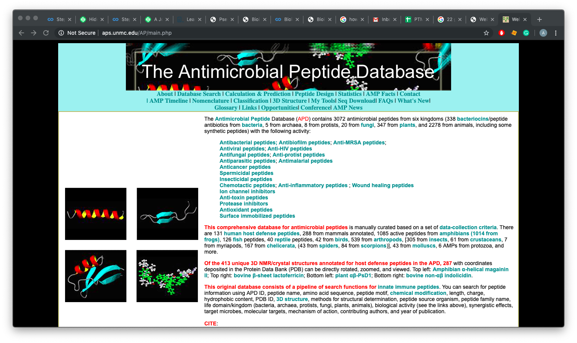
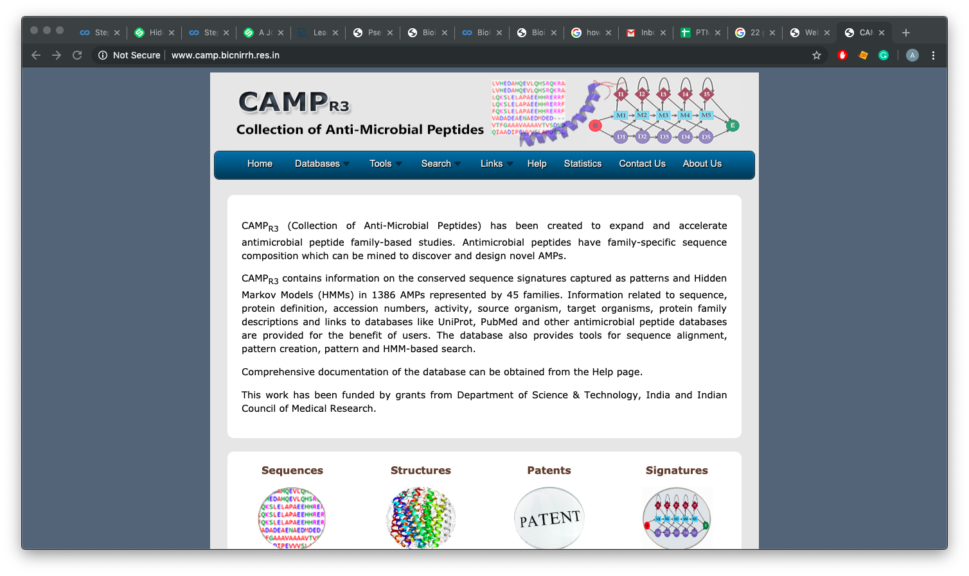
Methodology 1) Retrieval of sequences
Retrieval of Antimicrobial peptides in Bombyx mori from CAMP, APD3 and Pfam databases
Full length sequences of AMPs were retrieved from UniProt, CAMP and Pfam
Propeptide and mature peptide lengths were obtained from UniProt
Signal peptides of the full length AMPs were obtained from SignalP and Phobius
Schematic representation was created using Illustrator for Biological Sciences (IBS)

Slide 8
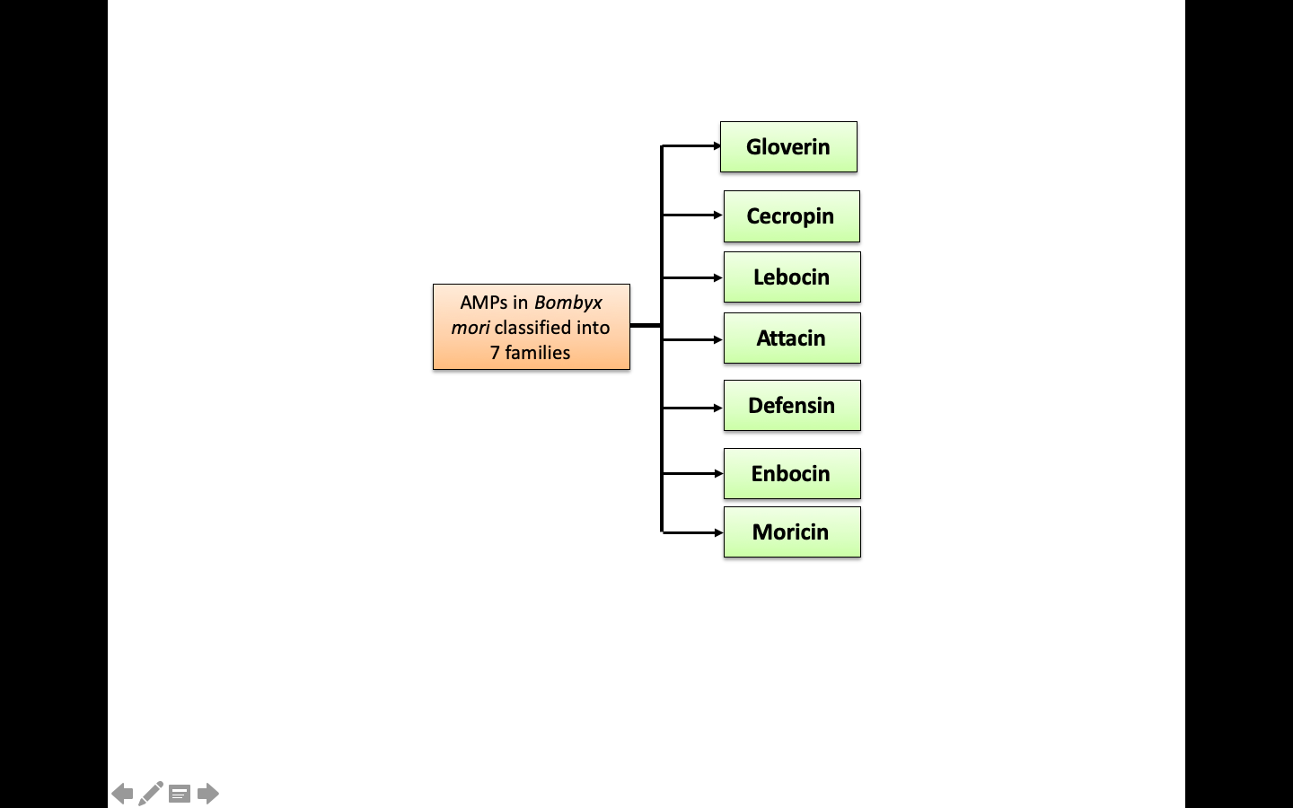
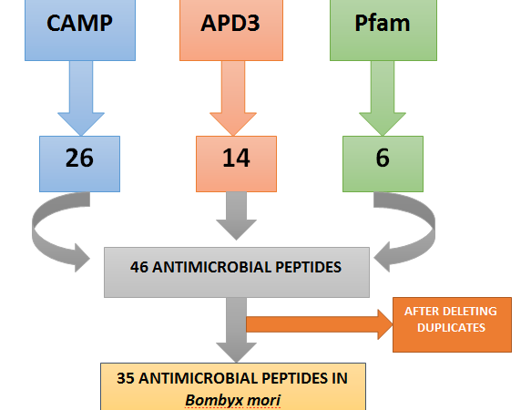
Results for Retrieval of AMP Sequences
Result indicating the total number of AMPs derived from CAMP, APD3 and Pfam databases

Slide 9
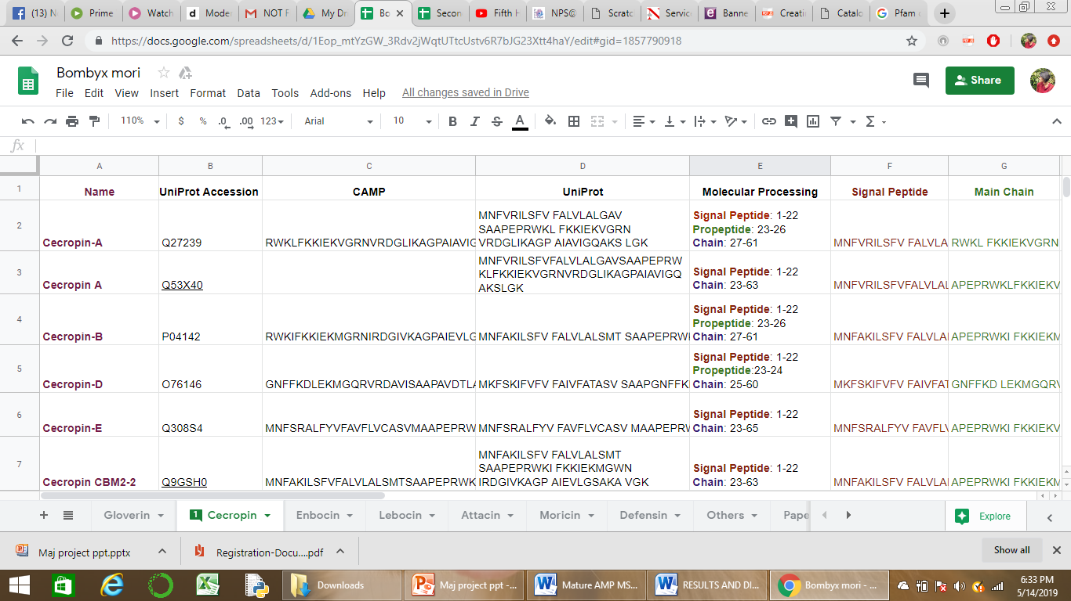
Result showing an organized excel sheet with AMP sequence data retrieved
For all the 35 AMPs, this was carried out

Slide 10
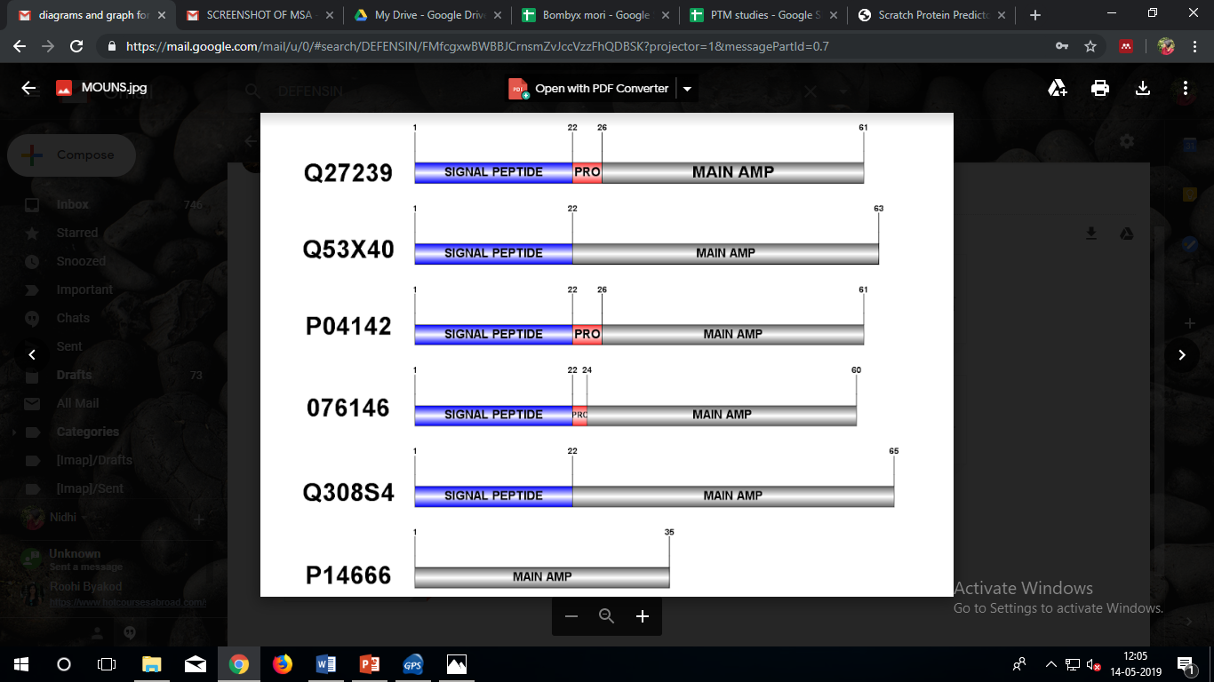
Schematic representation of full length sequence of AMPs created using IBS
Cecropin A
Cecropin
Cecropin B
Cecropin D
Cecropin E

Slide 11
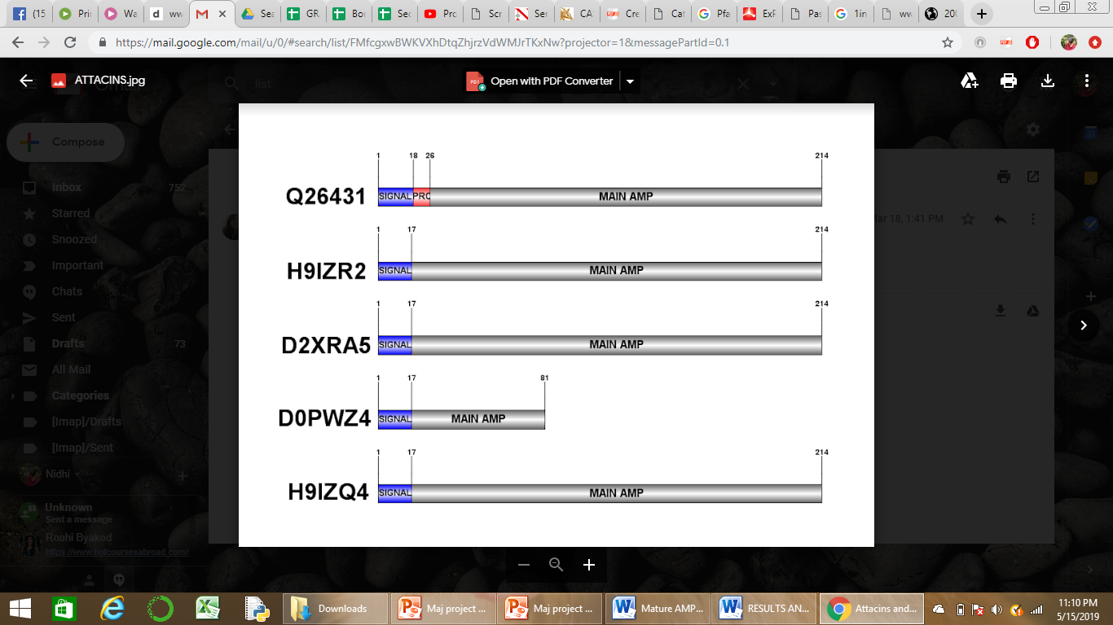
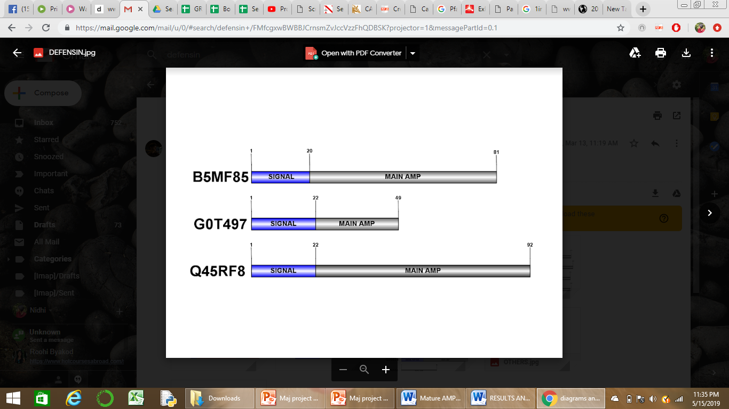
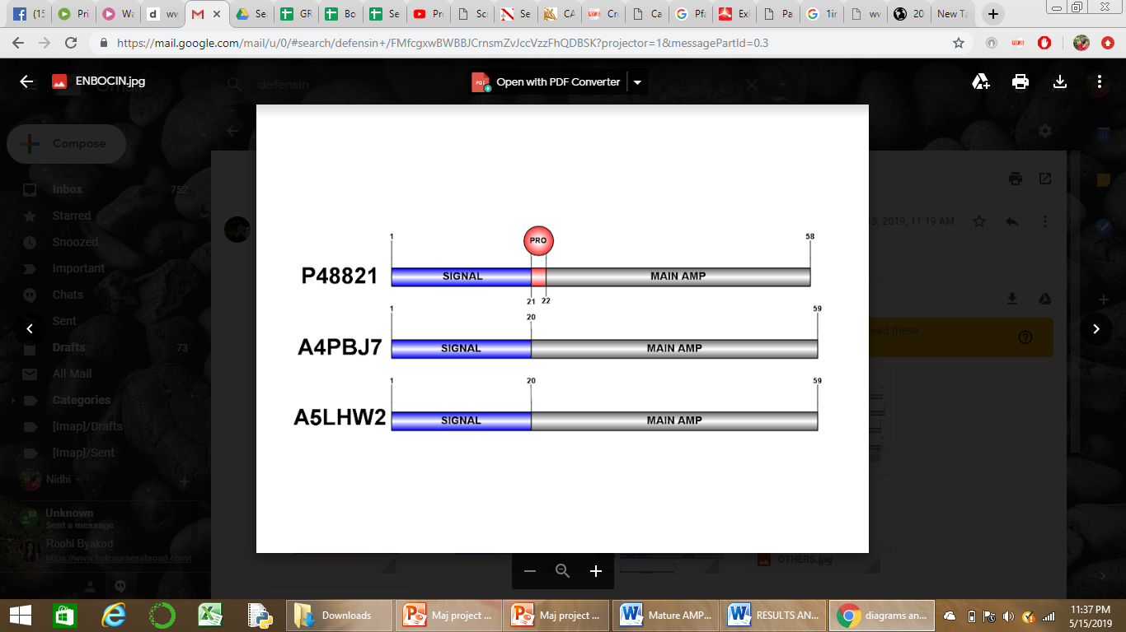
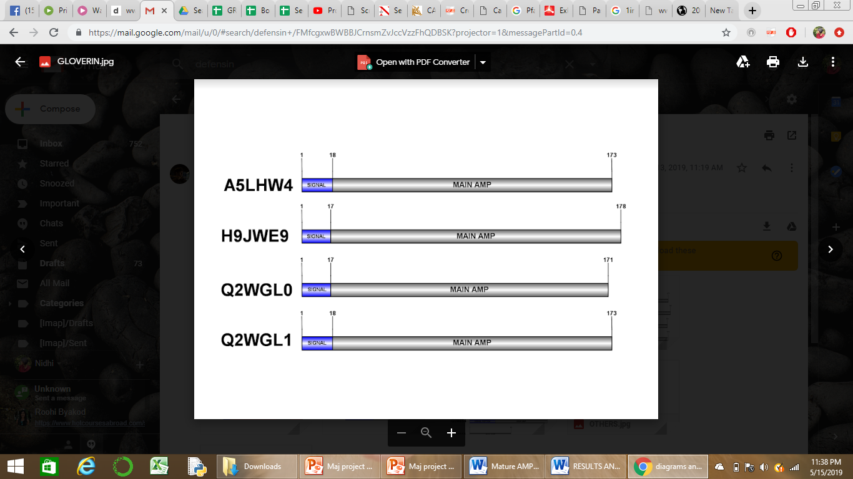
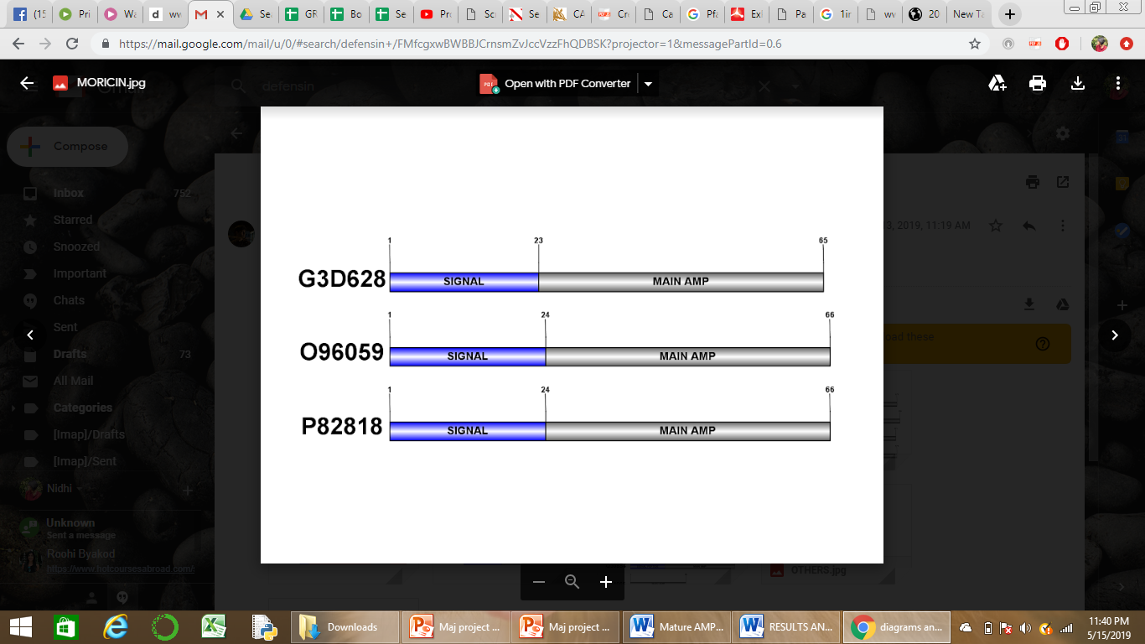
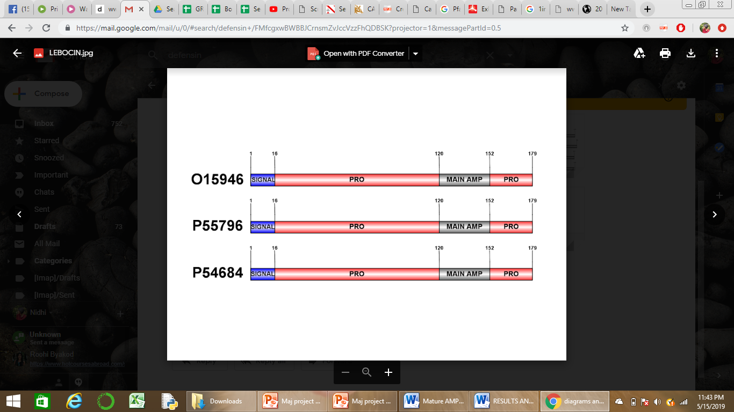
Defensin
Attacin
Enbocin
Gloverin
Moricin
Lebocin

Slide 12
Methodology 2) Primary Sequence Analysis
Mature peptide sequences were subjected to analysis by ExPASy- ProtParam
Net charge at neutral pH was calculated using Protein Calculator v3.4
Amino acid composition of each AMP was obtained from ExPASy ProtParam and the average of each amino acid was plotted on a graph
Post translational modification studies were carried out using ModPred and schematic representations were created using IBS

Slide 13
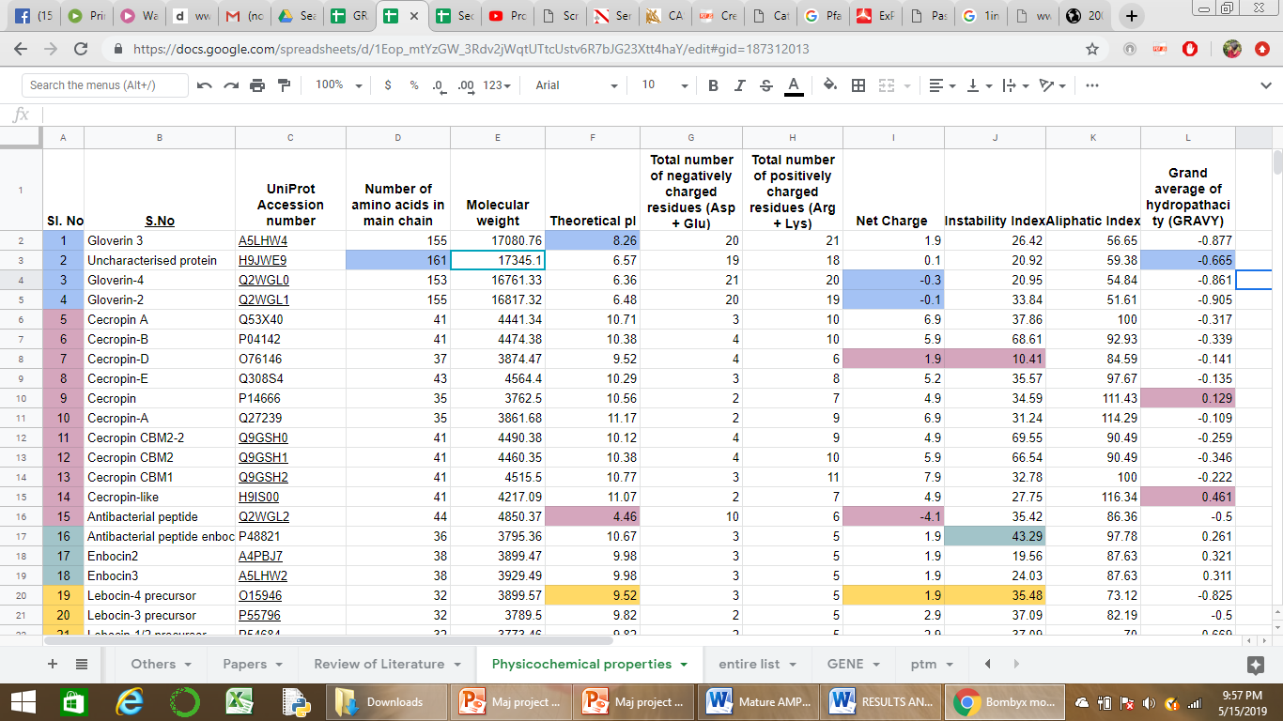
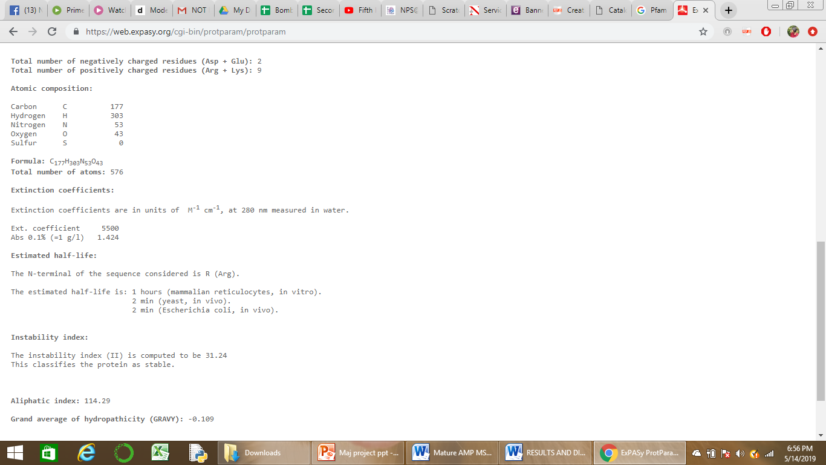
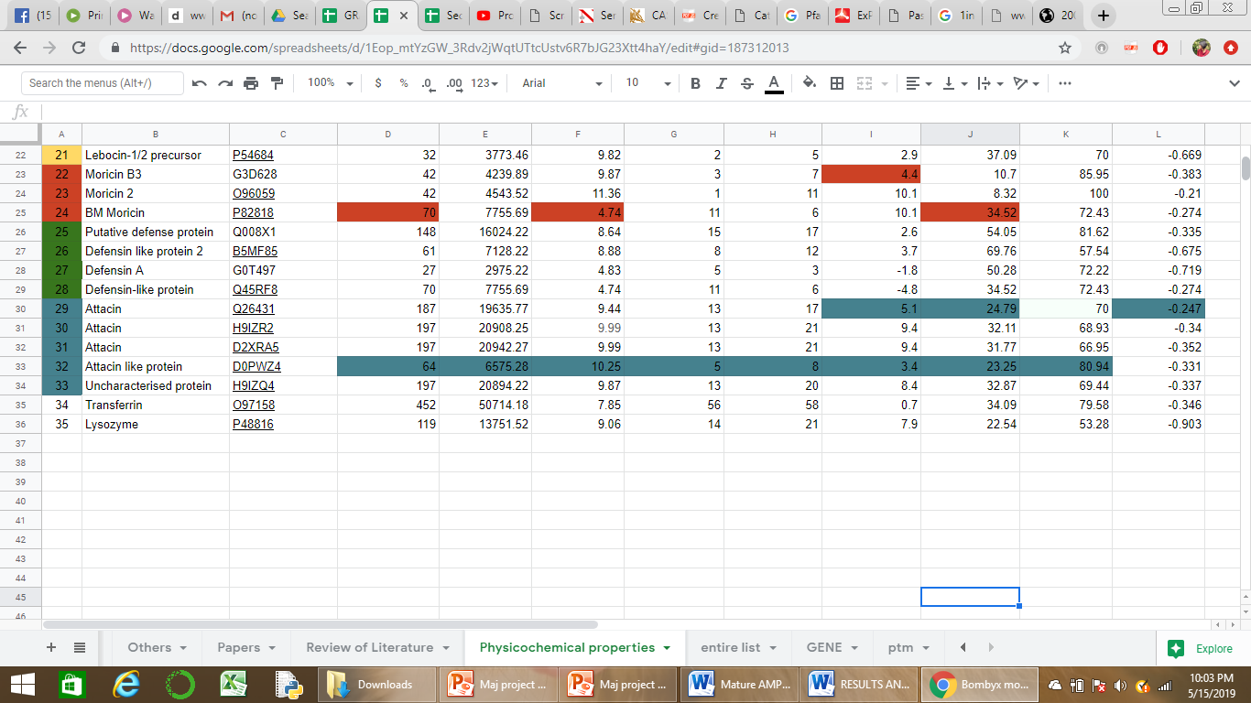
Result for Primary Sequence analysis
ExPASy-ProtParam result which yields physicochemical properties

Slide 14
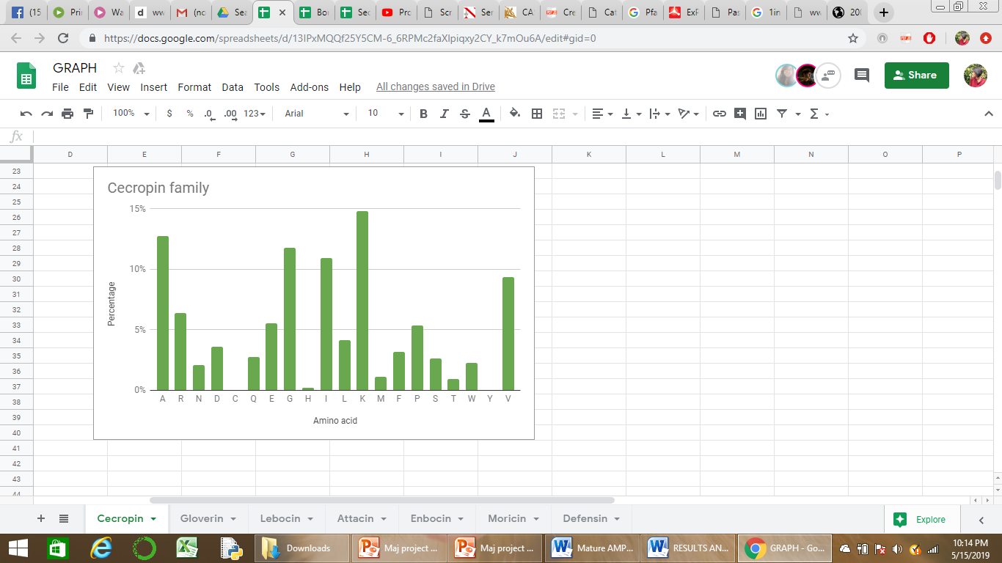
Amino acid composition data retrieved from ExPASy
Highest ranked AA – K with 14.82%
2nd highest ranked AA – A with 13%
3rd highest ranked AA – G with 11.81%

Slide 15
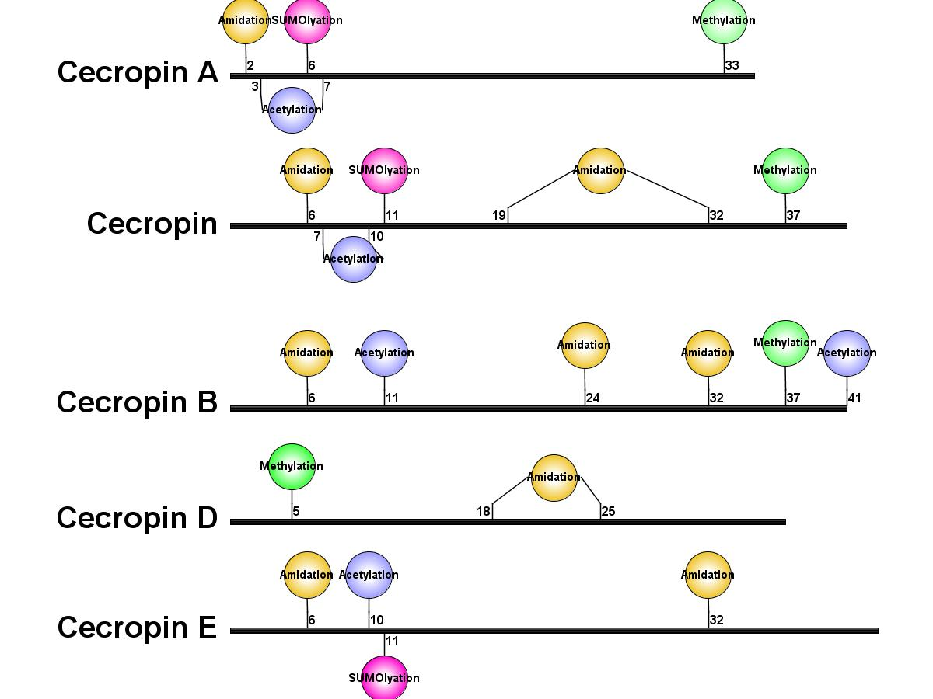
PTM schematic representation

Slide 16
Methodology 3) Secondary Structure Prediction
Literature was studied to decide the tools for Secondary Structure Prediction
Mature peptide sequences were submitted to GOR4, SOPMA, SSPRO and PORTER for analysis
Secondary Structure data was retrieved and organized into an Excel sheet
For the final prediction of secondary structure, weighted average method was adopted where the accuracy percentages were assigned to a score.
The models of the predicted secondary structures were created using Polyview

Slide 17
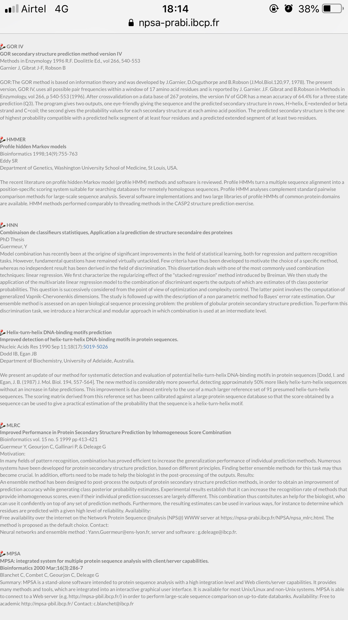
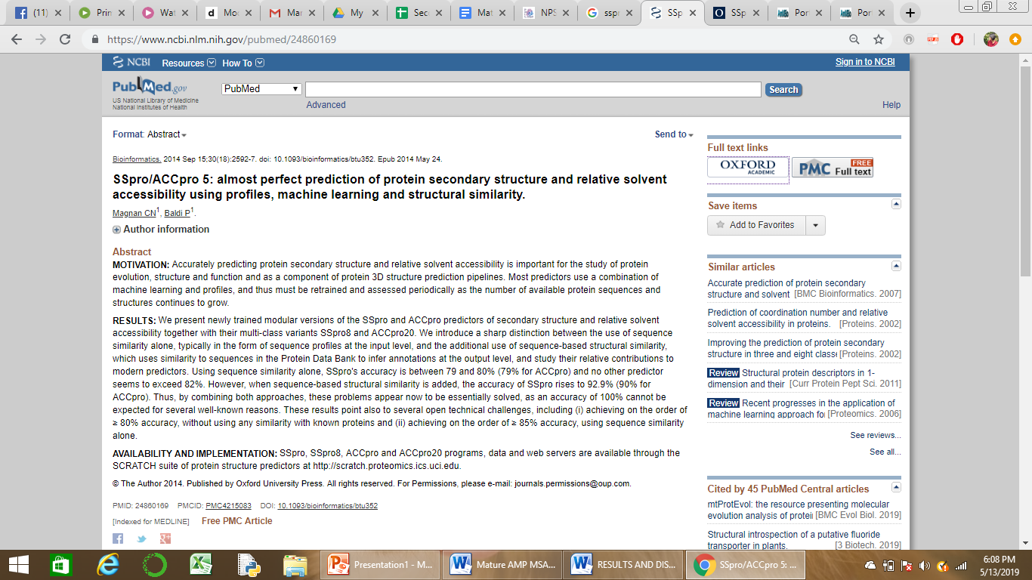
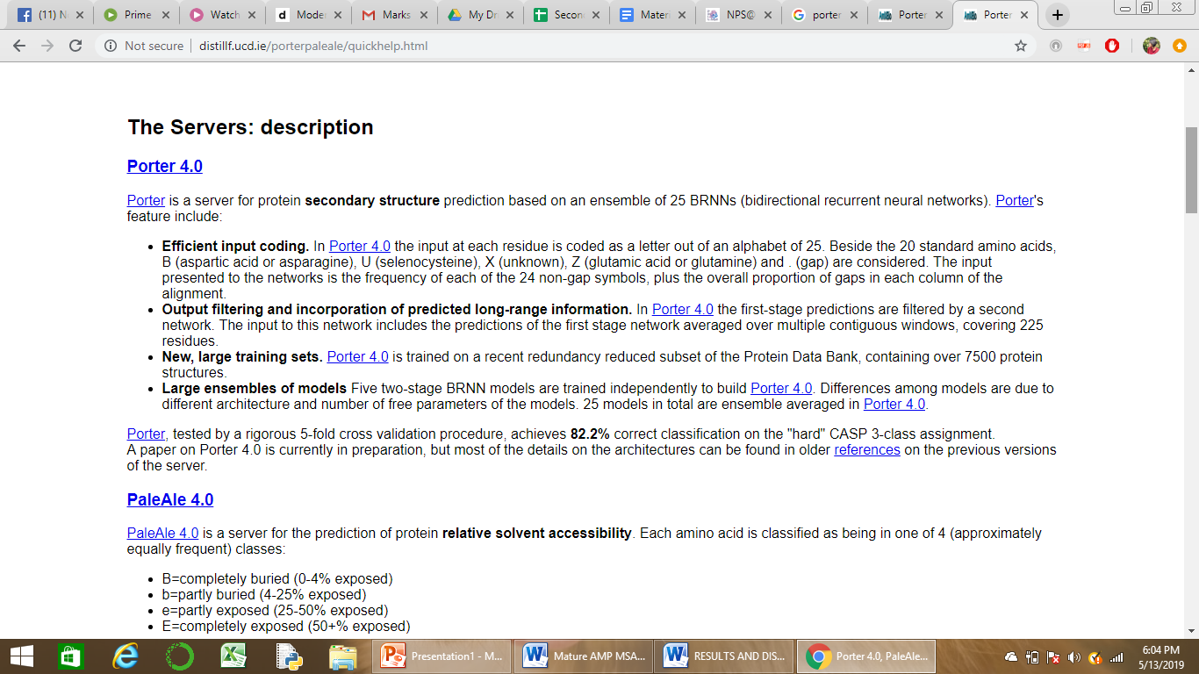
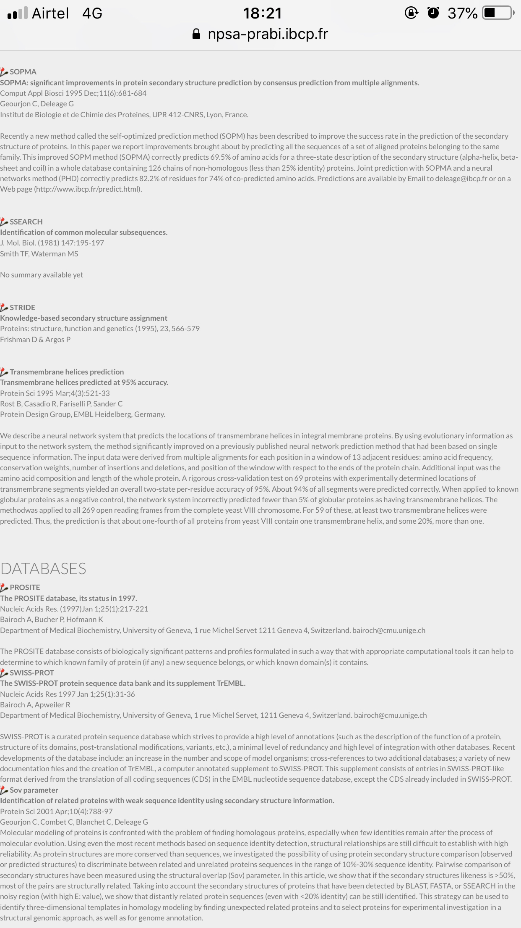
SECONDARY STRUCTURE PREDICTION
4 tools were utilized to obtain the secondary structure of AMPs, namely, GOR4, SOPMA, SSPRO and PORTER.
From literature we understood the accuracy level of each tool.
GOR4 – 64.4% - SSPRO – 92.9%
SOPMA – 69.5% - PORTER – 82.2%
SSPro predicts with 92.9% accuracy
GOR IV predicts secondary structure with 64.4% accuracy
SOPMA predicts with 69.5% accuracy
Porter 4.0 predicts with 82.2% accuracy

Slide 18
SSPro being the highly accurate tool was assigned a score of 1.
Relatively, GOR IV, SOPMA and Porter 4.0 were given a score of 0.7, 0.75 and 0.89 respectively.

Slide 19
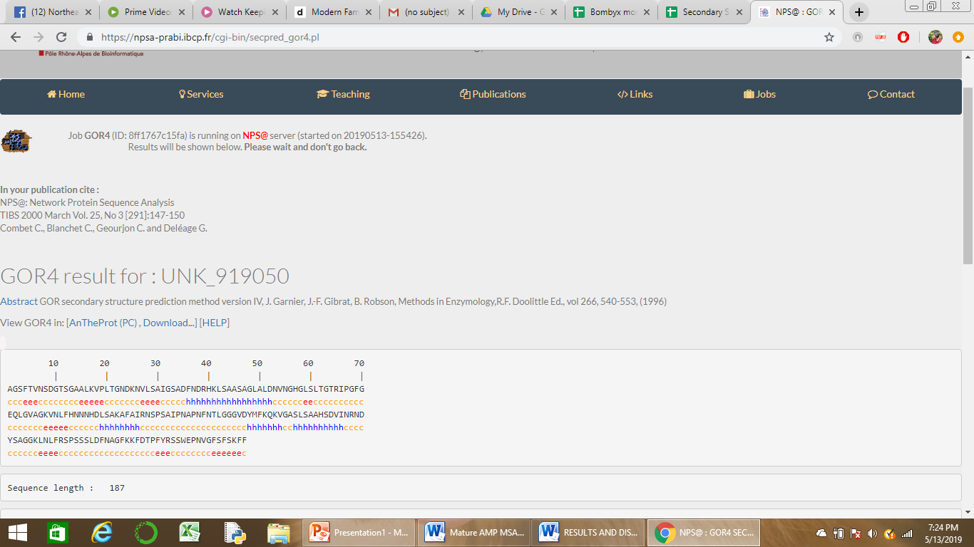
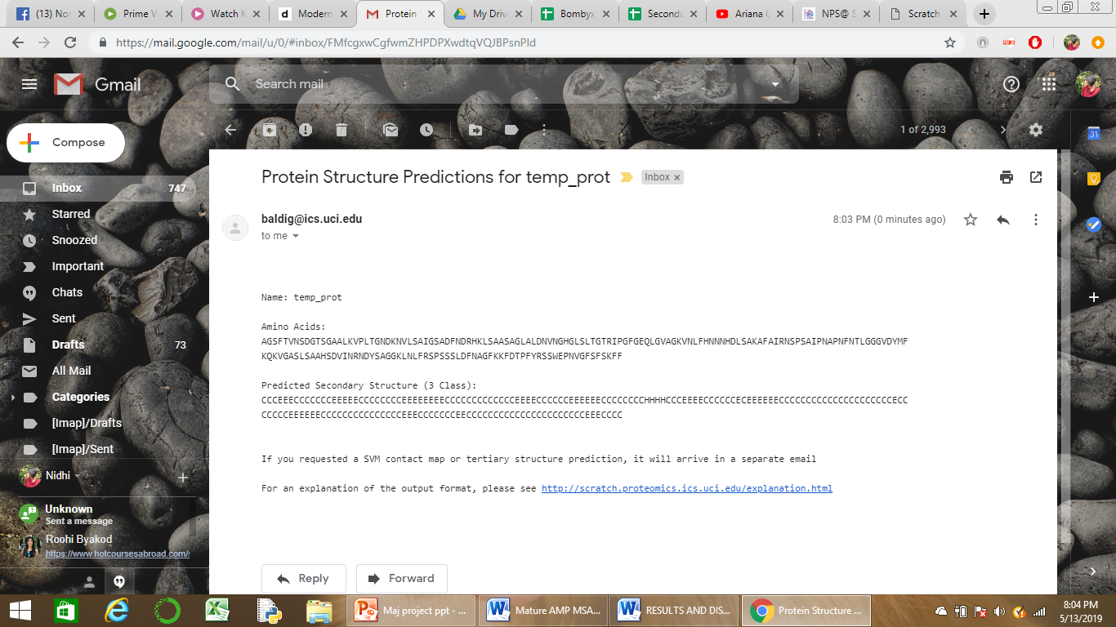
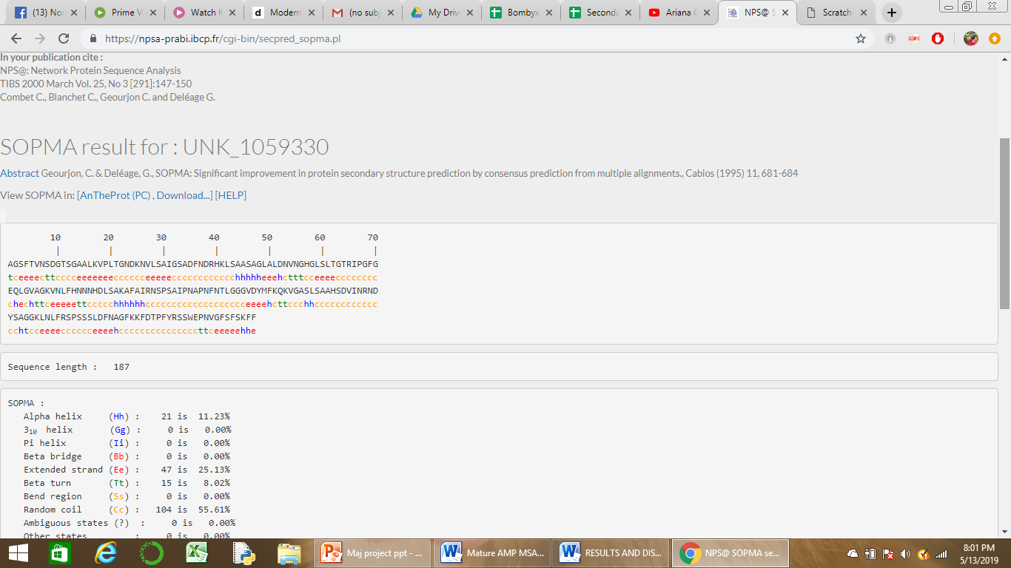
SSPro result
This is an example of Attacin (Q26431) AMP
MAIN CHAIN - AGS FTVNSDGTSG AALKVPLTGN DKNVLSAIGS ADFNDRHKLS AASAGLALDN VNGHGLSLTG TRIPGFGEQL GVAGKVNLFH NNNHDLSAKA FAIRNSPSAI PNAPNFNTLG GGVDYMFKQK VGASLSAAHS DVINRNDYSA GGKLNLFRSP SSSLDFNAGF KKFDTPFYRS SWEPNVGFSF SKFF

Slide 20
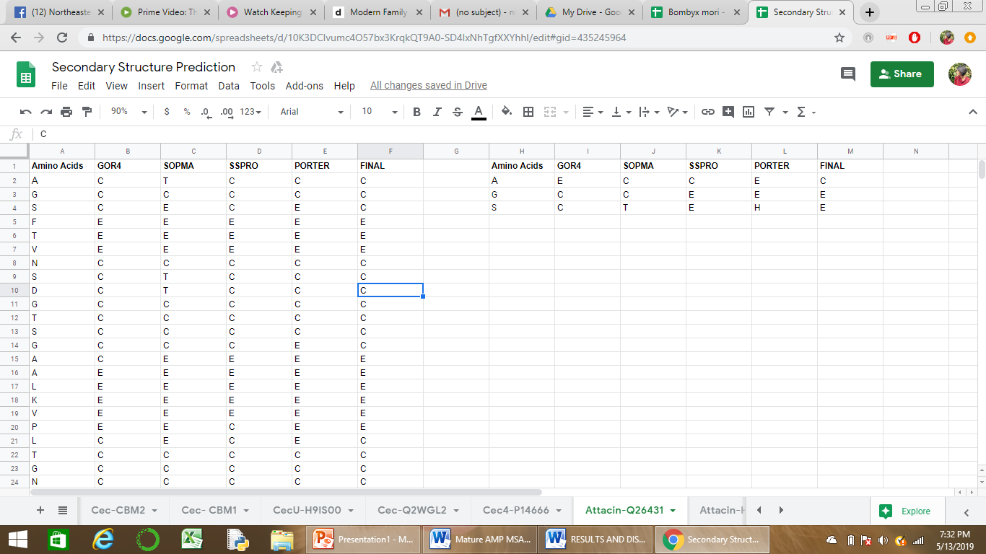
The final deduction of the AMP was achieved by using the weighted average method.
SCORES
0.7 0.75 1 0.89
COIL
TURN
EXTENDED STRAND
HELIX

Slide 21
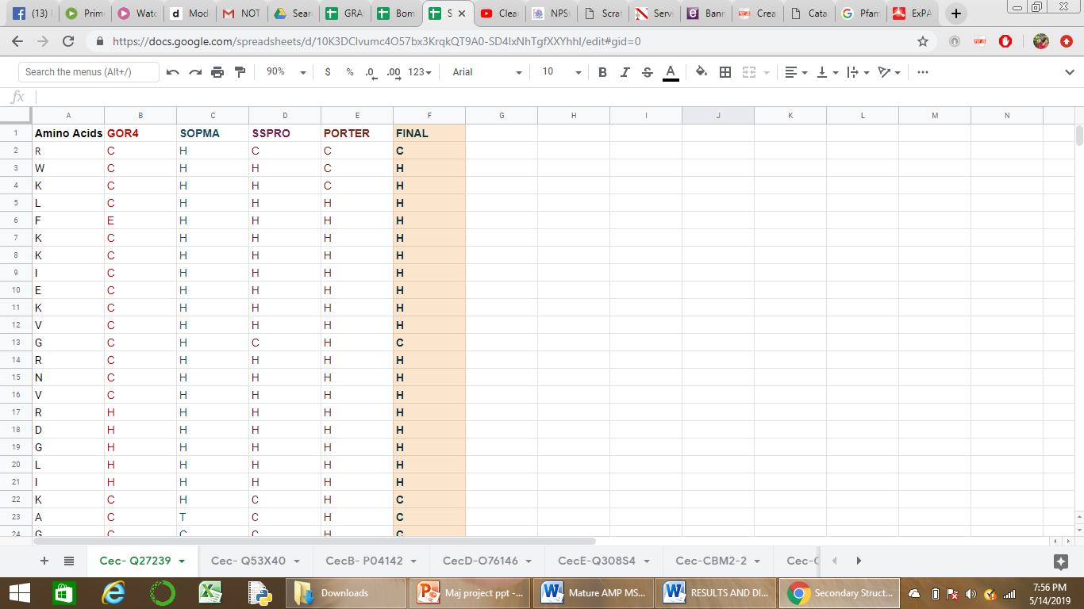
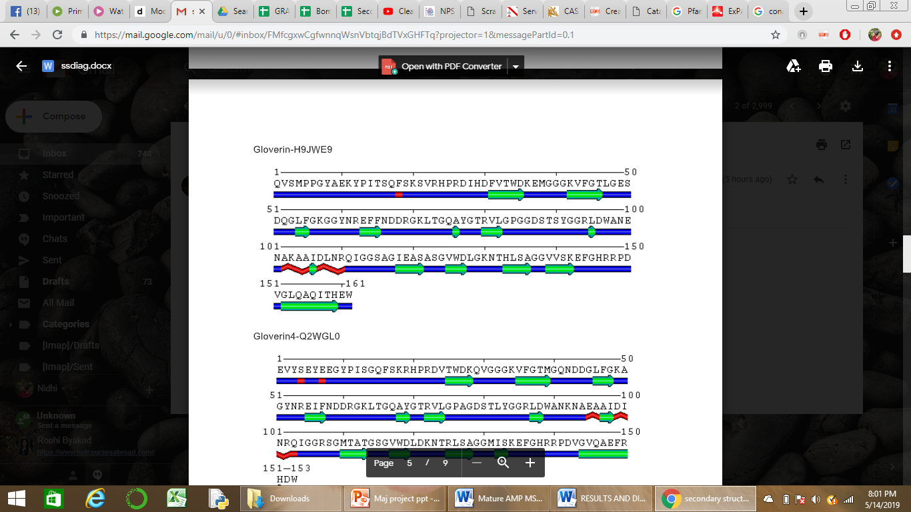
Model of secondary structure predicted for GLOVERIN
An excel worksheet containing final prediction of Secondary structure using weighted average method
C
E
H
This was done for 35 AMPs

Slide 22
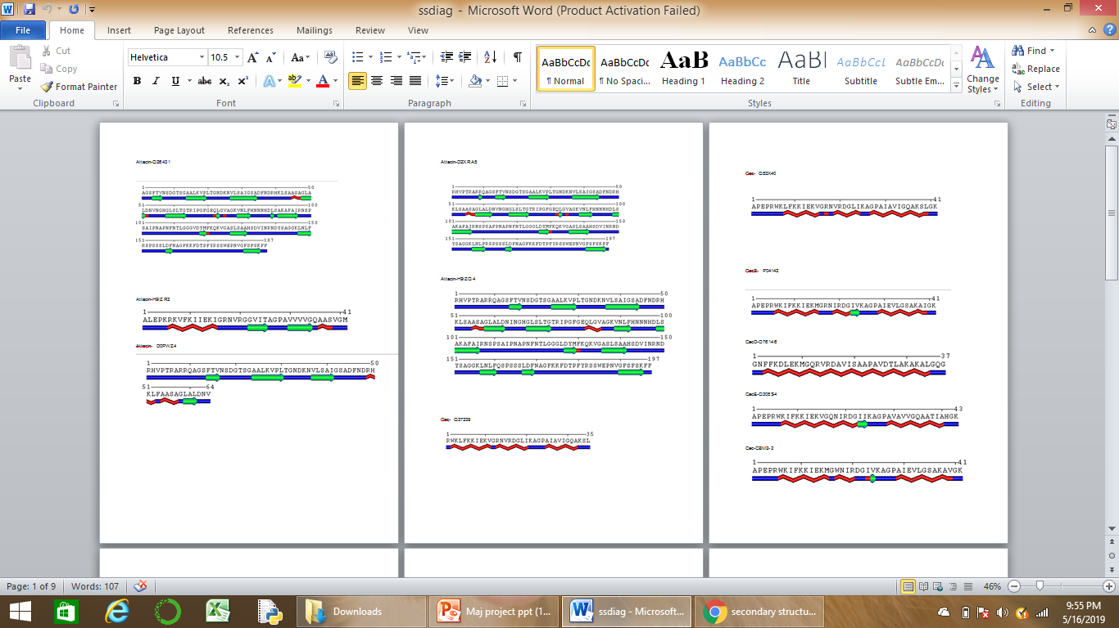
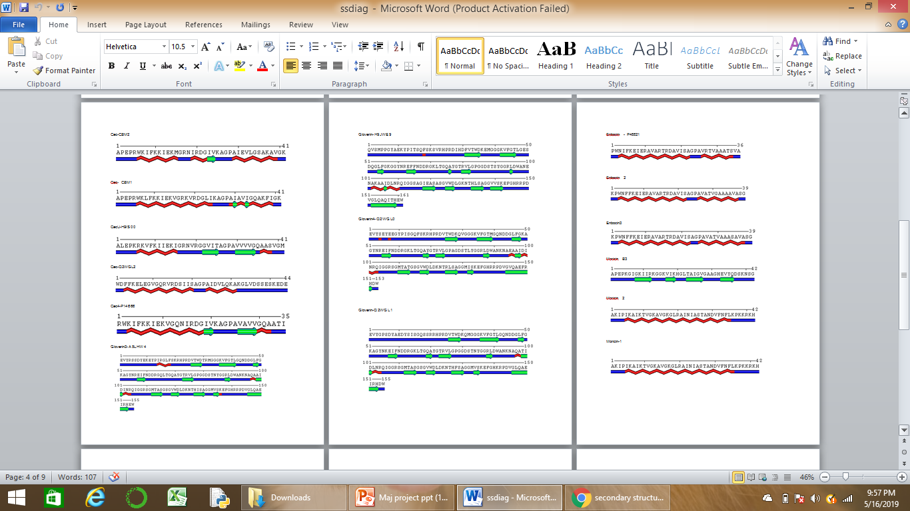

Slide 23
CONCLUSIONS
pI ~10 is similar to detergents or emulsifying agents which assists the mechanism of action for interacting with lipid bilayer of biological membrane.
Most AMPs are hydrophilic and cationic, which promotes selectivity for negatively charged microbial cytoplasmic membranes.
They also show stability over a wide range of temperatures as indicated by Aliphatic and instability index.
All AMPs have signal peptide and propeptides which are cleaved during activation or maturation. Amidated peptides are less sensitive to proteolytic degradation, extending their half-life in the bloodstream.
Secondary structures of 35 AMPs were solved and they were classified into non-αβ and α family. Cecropin, Enbocin and Moricin fall under the α family of secondary structures. Gloverin, Defensin, Lebocin and Attacin fall under non-αβ family of secondary structures.

Slide 24
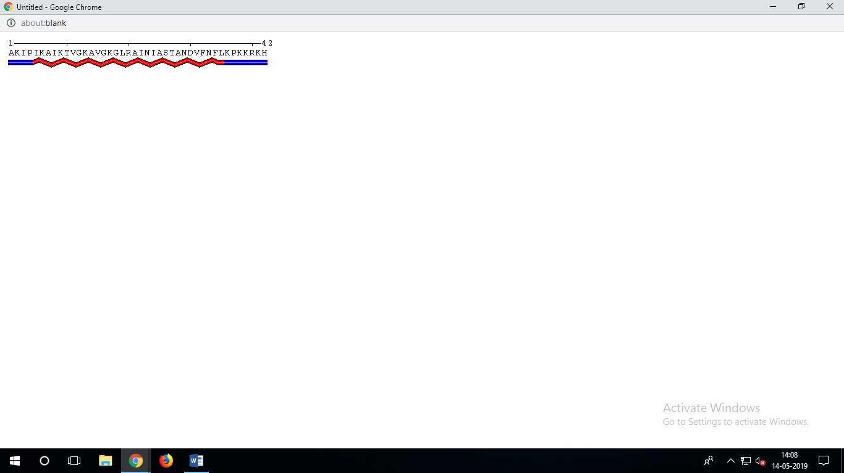
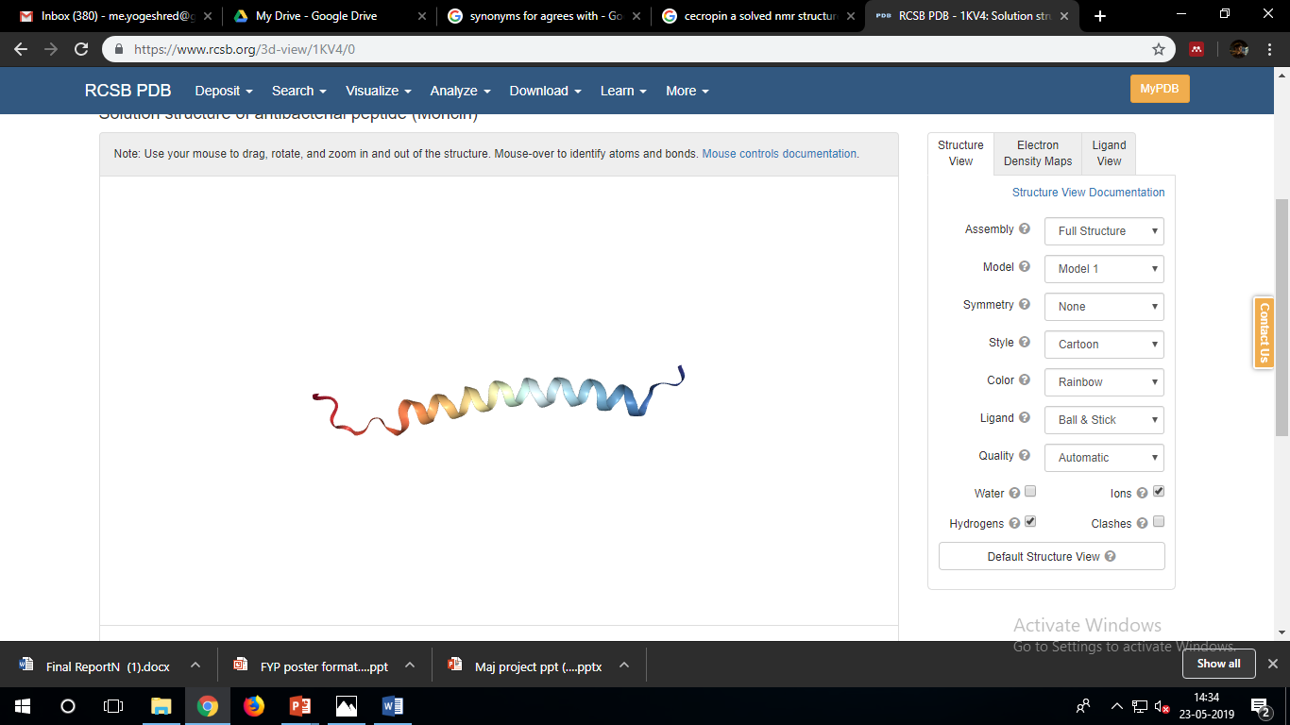
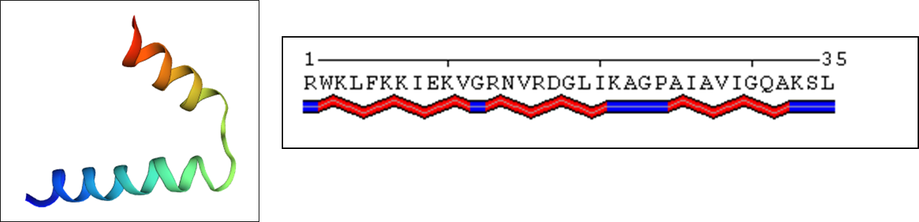
Lebocins are Pro-rich; Proline- helix breaker AA, There is a perfect correlation between amino acid composition and it’s predicted secondary structure of Lebocins (highly coiled). Enbocins are Ala-rich; Alanine- helix maker AA. , There is a perfect correlation between amino acid composition and it’s predicted secondary structure of Enbocins (Highly helical)
The predicted secondary structure of BM Moricin agrees with the experimentally proven structure. Moricins have alternating charged and hydrophobic residues which is a characteristic of alpha helices.
The predicted structure of Cecropin A concurs with the structure determined by Proton-NMR. Almost all Cecropins have 2 helical regions with a GP sequence in the middle

Slide 25
APPLICATIONS AND FUTURE SCOPE
We are heading for a “post-antibiotic era,” in which the previously effective therapeutic strategies are no longer relevant. The antimicrobial peptides (AMPs) have rapidly captured attention as novel drug candidates.
Though AMPs have potential therapeutic role, not much is known about sequence- structure- function correlation. This is very important to be able to engineer novel AMP-based drugs.
Our work provides certain inputs in this area of sequence- structure- function correlation of AMPs.
In future, more studies will be performed on immunoinformatics, in vivo half life, prediction of mechanism which are very essential properties for a potential therapeutic.
In collaboration with peptide chemists, we hope to generate AMPs which possess properties of drug candidates and can potentially be used as a therapeutic.

Slide 26
REFERENCES
Bulet, Phillipe, Charles Hetru, Jean Luc Dimarcq, and Daniéle Hoffmann. 1999. “Antimicrobial Peptides in Insects; Structure and Function.” Developmental and Comparative Immunology.
Cheng, J., A. Z. Randall, M. J. Sweredoski, and P. Baldi. 2005. “SCRATCH: A Protein Structure and Structural Feature Prediction Server.” Nucleic Acids Research.
Garnier, J., J. Gibrat, and B. Robson. 1996. “GOR Secondary Structure Prediction Method Version IV.” Methods in Enzymology
Kaito, Chikara, Nobuyoshi Akimitsu, Haruo Watanabe, and Kazuhisa Sekimizu. 2002. “Silkworm Larvae as an Animal Model of Bacterial Infection Pathogenic to Humans.” Microbial Pathogenesis.

Slide 27
AKNOWLEDGEMENT
We would like to thank our guide Dr. Sravanti V for her valuable guidance and encouragement.
We express our sincere gratitude to the Head of Department of Biotechnology, Dr. Bindu S and the Department of Biotechnology for providing us an opportunity to work on this project.

